Slide 1
Project 3: Web APIs & Classification
Tay jia xing

Slide 2
Problem statement
Using data obtained from scraping reddit, to train a classifier to predict which subreddit a given post came from.
Data collection / web scraping
Scrape data from www.reddit.com.
Subreddits are Parenting and Childfree
1000 posts each
Notes:
Parenting discusses mainly on the issues pertaining to raising a child or the joy of having a child
Childfree mainly discusses events that prompts people not to have child or the joy of not having a child.

Slide 3
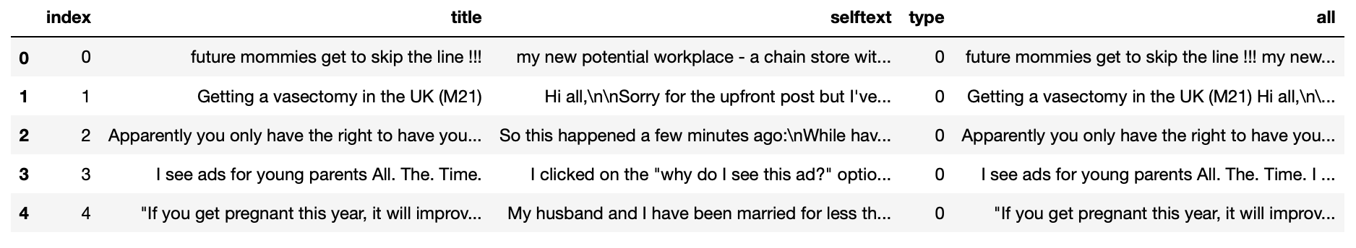
Data Cleaning
Created new column ‘all’ to store all title and selftext.
Null values
Contains only Alphanumeric
Remove stop words and childfree/child-free
Lemmatize and stem
Lower case

Slide 4
Modelling
Baseline model – 50% accuracy
CountVectorizer
LogisticRegression
MultinomialNB
TfidfVectorizer
AdaBoostClassifier
VotingClassifier
HashingVectorizer

Slide 5
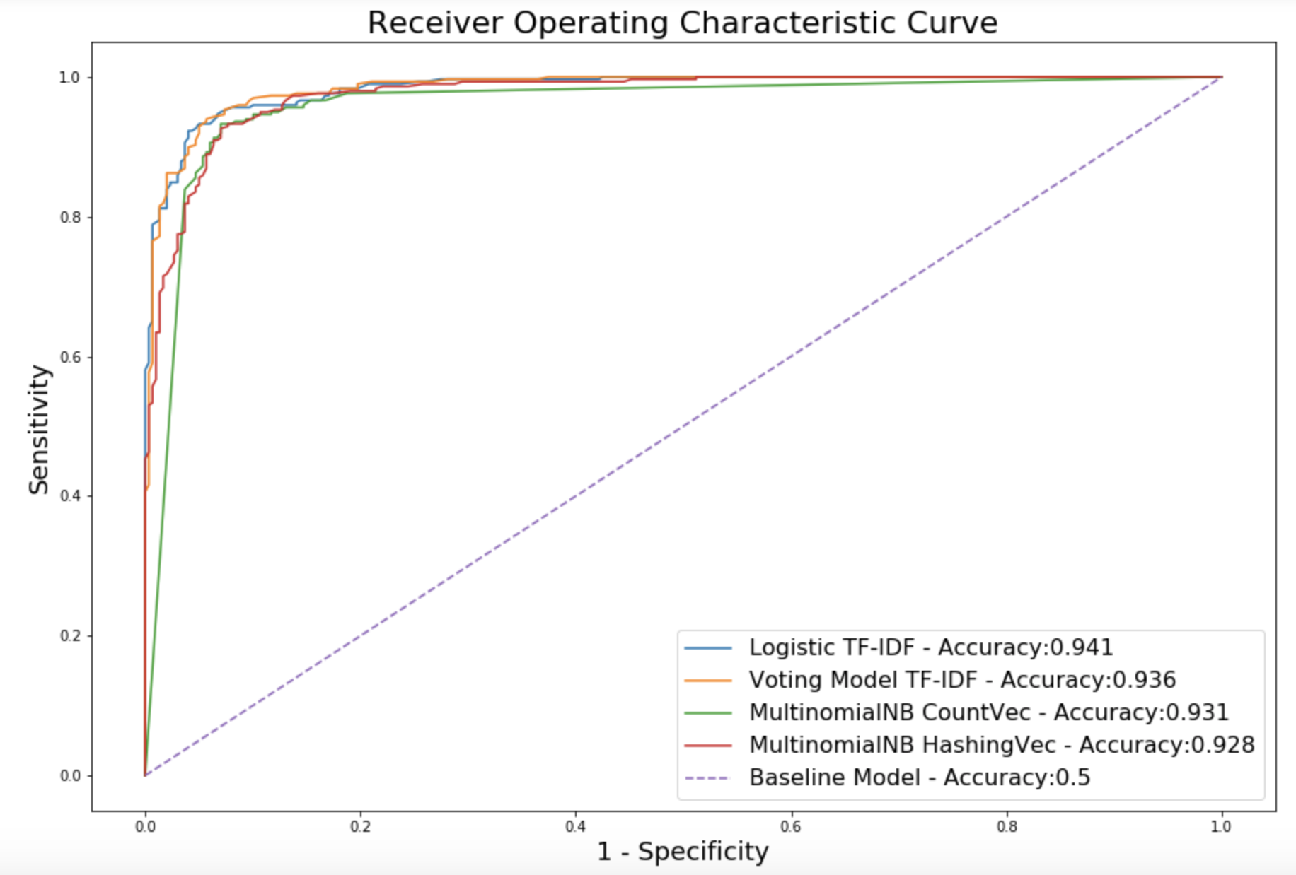
Modelling
Vectorizer | TF-IDF | CountVectorizer | HashingVectorizer | TF-IDF
Models | LogisticRegression | MultinomialNB | MultinomialNB | VotingClassifier
Train Accuracy | 0.993 | 0.947 | 0.966 | 0.984
Test Accuracy | 0.941 | 0.931 | 0.928 | 0.936
Cross Validation
Gridsearch

Slide 6
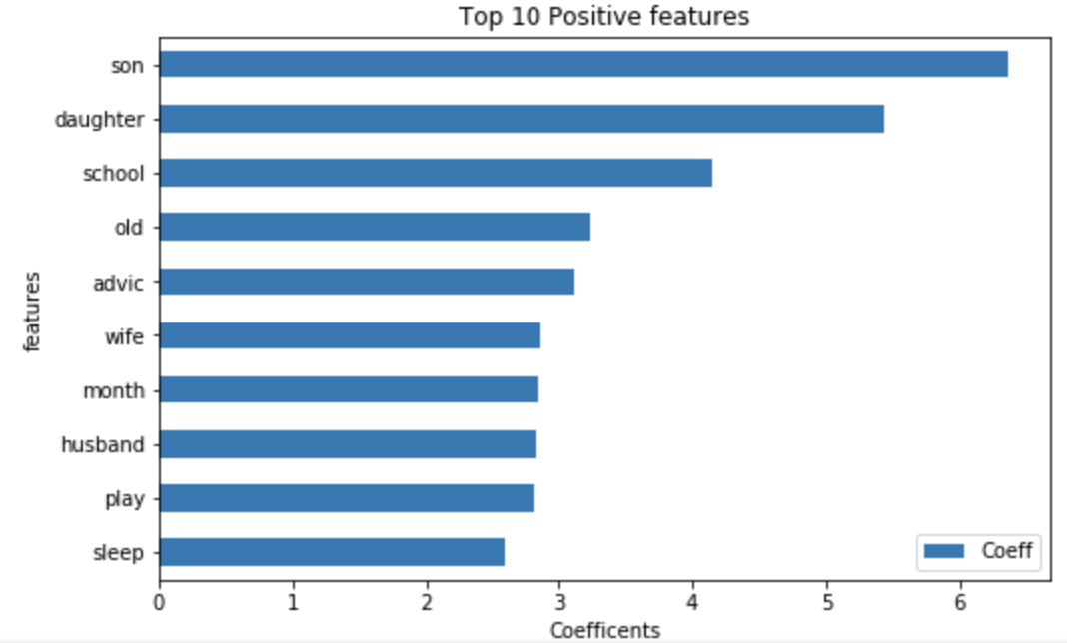
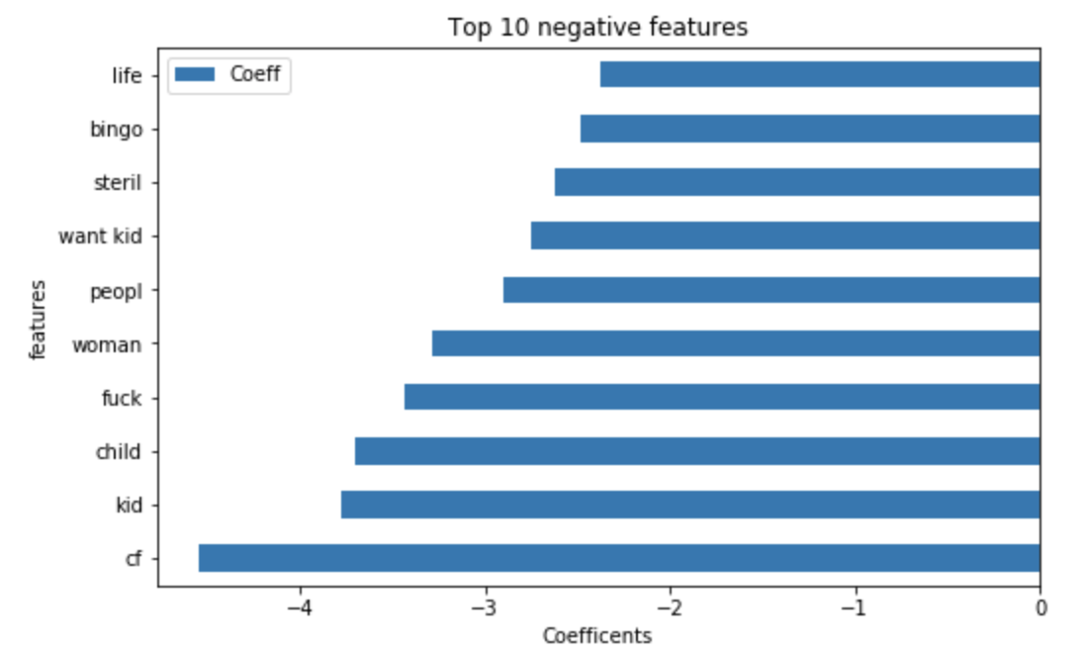
conclusion
Best Model : TF-IDF – Logistic Regression
Lowest misclassification rate 5.9%
No control over choice of words by users.

